Slide 1


Slide 2
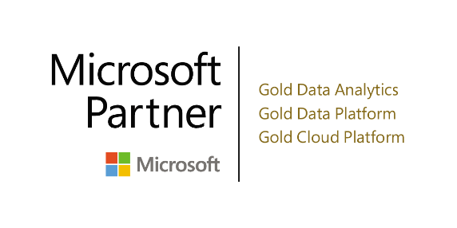
Tabular Automation With TMSL and PowerShell
Ust Oldfield | Adatis
15/02/2018

Slide 3

Ust Oldfield
Senior Consultant at Adatis
Love to travel
Enjoy trying to make things more efficient
Notes:
I’m a Senior Consultant at Adatis. We’re an Advanced Analytics and Business Intelligence Consultancy based in London and Farnham, Surrey
Outside of work, I love to travel and would rather spend more time travelling than doing boring, monotonous tasks
Therefore, I enjoy trying to make things more efficient. I don’t always succeed, but I enjoy it nevertheless.
Who’s used Tabular? Who enjoys developing in Visual Studio?
Who was excited when XMLA changed to TMSL (aka: tabular model scripting language) as I WAS?

Slide 4
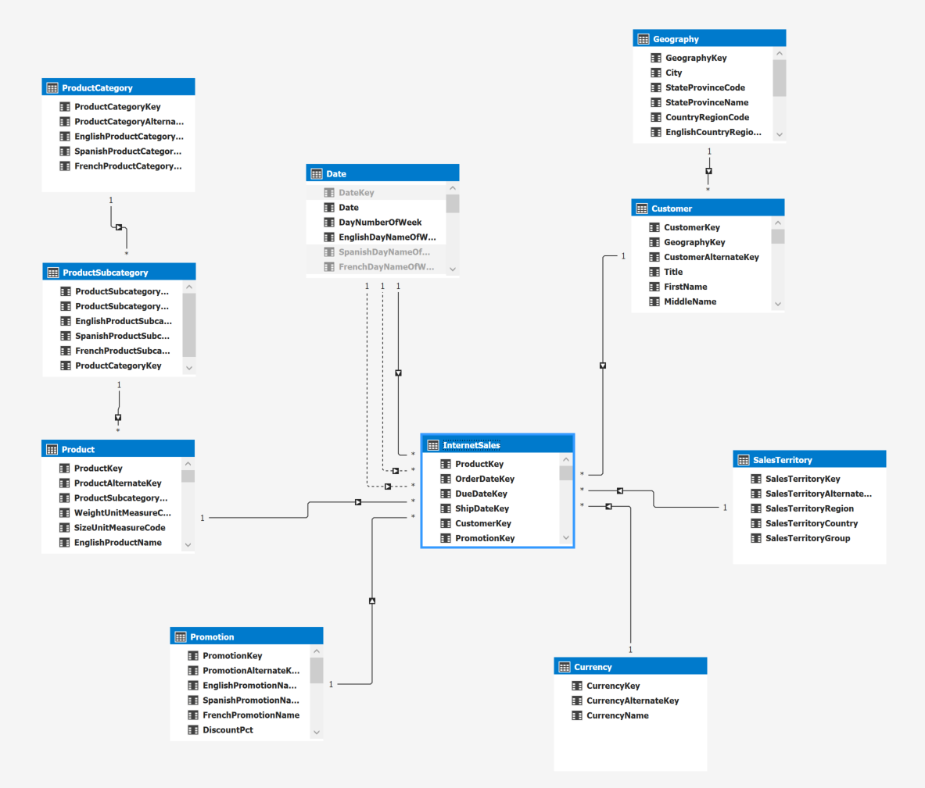
Tabular
In-Memory
SSDT
Semantic Layer
Notes:
Tabular’s analytics engine utilises compression algorithms and a multi-threaded query processor to deliver fast access to tabular model objects and data by reporting client applications like Power BI and Excel.
Typically authored in SQL Server Data Tools, which provides a design surface for creating models and associated objects.
Tabular is a representation of your Kimball modelled data warehouse, its tables and columns, allowing you to extend your warehouse by adding measures, KPIs, hierarchies and many other features that you can’t produce in your relational database.

Slide 5
Tabular in a Warehouse Architecture

Slide 6
Tabular in a Warehouse Architecture

Slide 7
Why Use Tabular
Corporate Data Models
Fast Analytics Engine
Easy To Develop
Notes:
Have a sanitised, single source and interpretation of data for business users to analyse
Due to the compression algorithms, in-memory storage and multithreaded query processor, tabular has a very fast analytics engine for users to query and analyse data without having to rely upon IT for their analytical demands
For many users who analyse data in Excel or Power BI, the experience of using tabular models and creating DAX expressions is familiar – meaning it’s relatively easy to understand and implement. Tabular does not contain the same complexities of developing multidimensional cubes or creating MDX queries – which makes it faster to develop than Multidimensional

Slide 8
The Problems…
I’ve got 99 problems and the DAX ain’t one
Notes:
With TMSL and PowerShell, what problem or problems am I trying to solve..?
There are a multitude of problems, DAX not being one of them, that I or others have faced when developing or using tabular models

Slide 9
Agenda
Business Built Tabular
Model Now
Don’t know SSAS / DAX
What’s Visual Studio?
Notes:
wouldn’t it be great if self service BI was EVEN MORE SELF SERVICE - enabling Business users who want to build their own tabular models, to build their own tabular models
You might be thinking, “You’re mad!” and you would be right. It is an unusual request and has its own challenges
As a business user…
I want a tabular model now
BUT I don’t know SSAS or much DAX, if any at all
Development tools? What are they?!

Slide 10
Agenda
Slow Development
Fast Development
Basics of a model
Less time doing mundane tasks
Notes:
To be able to create a tabular model in seconds
I don’t need it all signing and dancing – just the basics is fine for me
Do more exciting things, like complex DAX

Slide 11
Agenda
Large Data Set
Volumes too big
Selective analysis period
Quick and Dynamic
Notes:
My data volumes are too big to be processed by a single tabular database
I want a tabular model to process one month at a time, because that’s all I’m going to be analysing
Because business demands are high, I need it quickly and dynamically

Slide 12
Solutions…?
Notes:
You could use tools like Tabular Editor or BIML to potentially resolve some of these problems, but we want to avoid 3rd party tools like tabular editor and we don’t want to pay a licence fee for BIML. It’s so easy to create a tool that automates the creation and deployment of tabular models.
I’ll show you…How easy it is to Introduce, or extend, a Tear-down, Build-up development culture in your organisation for tabular (and ideas for other areas) – using templates, metadata and automated scripts
So that you can quickly alter tabular objects and redeploy, including processing – even if that alteration is wholesale redevelopment

Slide 13
Agenda
Agenda
Intro TMSL
Intro PowerShell
Demos
Notes:
Introduction to TMSL
Introduction to PowerShell
And a series of demos highlighting the combined power and flexibility of using TMSL and PowerShell

Slide 14
Tabular Model Scripting Language (TMSL)
Introduced in SQL Server Analysis Services 2016
JSON Format
Description of objects in a tabular model
Commands to send to Analysis Services
Commands to manage a tabular model
Notes:
1200+ compatibility (as well as Azure Analysis Services)
Meaning it is easy to read and easy to template

Slide 15
Tabular Objects
Data Sources
Tables
Perspectives
Cultures
Roles
Relationships

Slide 16
Tabular Object Dependencies
Model
Data Sources
Tables
Perspectives
Cultures
Roles
Relationships
Columns
Perspective Tables
Translations
Members
Measures
Perspective Columns
Permissions
Partitions
Perspective Measures
Hierarchies
Perspective Hierarchies
Notes:
I realise this is next section is going to be dry, but I want you to get a quick feel for how each of the objects differs and how EASY it is to describe these things within the language
Bear in mind that I don’t just open up notepad and start typing – get a skeleton structure from a tabular model and go from there. Don’t recall the syntax? Build it through the GUI and check it!

Slide 17
Data Source Object
"dataSource": {
"name": "SqlServer localhost AdventureWorksDW2014",
"connectionString": "Provider=SQLNCLI11;Data Source=localhost;Initial Catalog=AdventureWorksDW2014;Integrated Security=SSPI;Persist Security Info=false",
"impersonationMode": "impersonateAccount",
"account": “DOMAIN\\USER"
}
default
impersonateAccount
impersonateAnonymous
impersonateCurrentUser
impersonateServiceAccount
impersonateUnattendedAccount
Notes:
The name of the data source will be referenced in the partition object. The naming convention is: the type of data source, followed by the server and then the database
There are several options for the impersonation mode, some of them also share the same characteristics as in Visual Studio

Slide 18
Table Object
"tables": [
{
"name": "Table Name",
"isHidden": false,
"columns": [<...>],
"partitions": [<...>],
"measures": [<...>],
"hierarchies": [<...>]
}
]
Notes:
A table, conceptually is very simple. All it requires is a name; at least one column; and at least one partition. Everything else, like a description, dataCategory, isHidden, Measures and hierarchies are optional.

Slide 19
Column Object
description
alignment
dataCategory
displayFolder
displayOrdinal
formatString
isAvailableInMDX
isDefaultImage
isDefaultLabel
isHidden
isKey
isNullable
isUnique
keepUniqueRows
sortByColumn
summarizeBy
tableDetailPosition
type
CALCULATED COLUMNS
isDataTypeInferred
expression
CALCULATED TABLES
sourceColumn
isNameInferred
columnOriginTable
columnOriginColumn
"columns": [
{
"name": "Column Name",
"dataType": "int64",
"sourceColumn": "ColumnName",
"sourceProviderType": "Integer"
}
]
Notes:
A column, is a bit more complex. It requires a name, a data type, a source column and a source data type.
There are plenty of additional options for columns. These are:

Slide 20
Partition Object
"partitions": [
{
"name": "Table Name",
"dataView": "full",
"source": {
"query": " SELECT [SchemaName].[TableName].* FROM [SchemaName].[TableName] ",
"dataSource": "SqlServer AdventureWorksDW2014"
}
}
]
Notes:
A partition requires a name, a data view and a source as its bear minimum.

Slide 21
Measure Object
"measures": [
{
"name": "Measure Name",
"expression": " COUNTX(InternetSales, InternetSales[OrderDateKey])"
}
]

Slide 22
Hierarchy Object
"hierarchies": [
{
"name": "Hierarchy Name",
"levels": [
{
"name": "Hierarchy Column1",
"ordinal": 0,
"column": "Table Column1"
},
{
"name": "Hierarchy Column2",
"ordinal": 1,
"column": "Table Column2"
]
}
]

Slide 23
Perspective Object
"perspectives": [
{
"name": "Perspective Name",
"tables": [
{
"name": "Table Name",
"columns": [<...>],
"measures": [<...>],
"hierarchies": [<...>]
}
]
}
]

Slide 24
Culture Object
"cultures": [
{
"name": "fr-FR",
"translations": [
{
"model": {
"name": "Model",
"translatedCaption": "Modèle",
"tables": [
{
"name": "TableName",
"translatedCaption": "NomDeLaTable",
"columns": [<...>]
}
]
}
}
]
}
]

Slide 25
Role Object
"role": {
"name": "Role",
"modelPermissions": "read",
"members": [
{
"memberName": "ujo",
"memberId": "S-1-5-21-2328473335-1214001268-1226958112-1001"
}
]
}

Slide 26
Relationship Object
"relationships": [
{
"name": "ManyTableNameToOneTableName",
"fromTable": "ManyTableName",
"fromColumn": "ForeignKey",
"toTable": "OneTableName",
"toColumn": "PrimaryKey"
}
]

Slide 27
TMSL Commands
"create":
"createOrReplace":
"refresh":
"alter":
"attach":
"backup":
"delete":
"detach":
"mergePartitions":
"restore":
"sequence":
"synchronize":

Slide 28

PowerShell
Command-line language
Used to administer operating systems
Used to automate processes
Uses cmdlets to extend functionality
Notes:
Who uses PowerShell?
If you want to know more about PowerShell, there’s plenty of sessions that you should’ve gone to at SQL Bits!
Command-line shell and scripting language
Typically used by system admins to administer operating systems
I’m not a DBA or a sysadmin but I use PowerShell all the time as a development tool!
Used to automate processes
Uses cmdlets to extend functionality
Sets of cmdlets can be combined into scripts

Slide 29
Invoke-ASCmd cmdlet
#Uses an input file to issue a command to an AS server
Invoke-ASCmd –InputFile "C:\folder-name\TMSLScript.json" -Server "localhost"
#Uses a Query to issue a command to an AS server
Invoke-ASCmd -Server "localhost" -Query "{""refresh"":{""type"": ""full"", ""objects"": [{""database"": ""AdventureWorks2014""}]}}"
Notes:
There are loads of AS cmdlets available, but the important cmdlet for this session is the Invoke-ASCmd cmdlet
Allows you to issue a command against the analysis services server, either from a file or as a query - and you’ll soon see how the two variations are used in the automation of tabular model development

Slide 30
The Dream Team
Metadata driven
Templates
Extendable
TMSL
Notes:
PowerShell has modules which can connect to SQL Server databases and read the contents of tables, as well as access DMVs. This means that you can drive the creation of metadata objects, using other metadata
TMSL, as it is a JSON object, allows for templates to exist, meaning that you have a standardised object from which to quickly draw upon and read within PowerShell.
With PowerShell you can add so much more into your TMSL file. It is fully extendable and can be used to connect to Azure services as well.

Slide 31
The Problems, again
Business Built Tabular
Slow Development
Large Data Set

Slide 32
Filtered Model From Template Flow
Find and Replace Values

Slide 33
Filtered Model From Template

Slide 34
Tabular Generation No Template Flow
object

Slide 35
Tabular Generation No Template

Slide 36
Tabular Generation From Template Flow
object
Find and Replace Values

Slide 37
Tabular Generation From Template

Slide 38
Summary
Filtered Model From Template
Tabular Generation No Template
Tabular Generation From Template
Notes:
Introduce a Tear-down, Build-up development culture. Quickly alter tabular objects and redeploy, including processing.

Slide 39
The Future…
Notes:
How can we use these demos in real business life?
For a filtered tabular model from template, the solution for our large data set problem, we could put a wrapper around the PowerShell script so that all users have to enter is the analysis period and the validity period for the tabular model. This wrapper could be anything… A Bot, a power app, a .NET wrapper, a web app. The options are almost endless…
What if we popped it on Azure, what could it look like?

Slide 40
The Future…
Notes:
For generating a tabular model from template, the solution for our slow development problem, again we could put a wrapper around the PowerShell script and our metastore so that users enter the metadata values and validity period for the tabular model.
Like our previous example, this wrapper could be anything… Writing metadata to our metastore, config db, and executing the PowerShell script
Popping it into Azure, could look like…

Slide 41
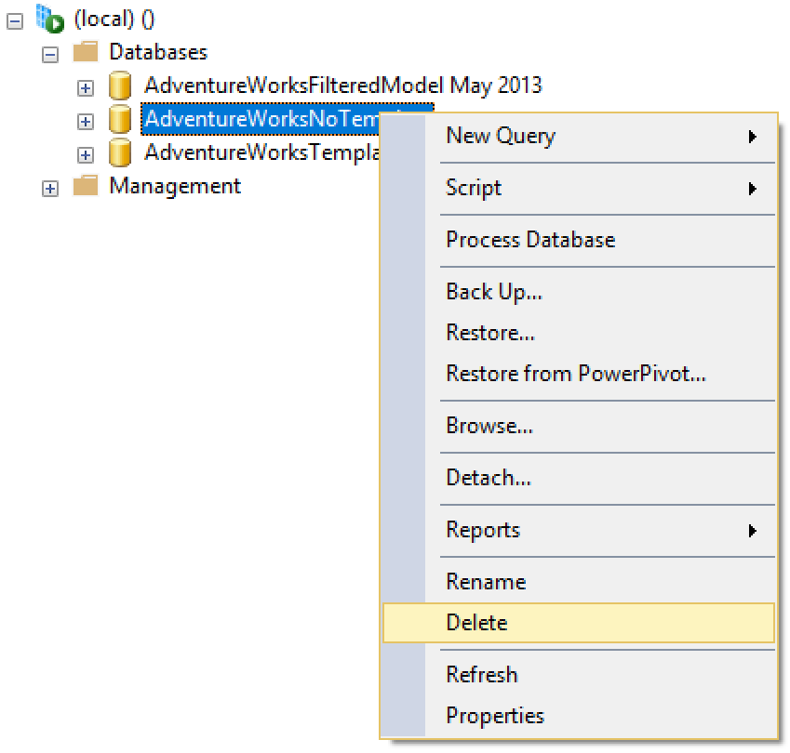
The Future…
Notes:
By employing the techniques of tabular automation demonstrated in this session, the management of tabular becomes less about managing individual model source code and more managing what models are live and whether they need to live.

Slide 42
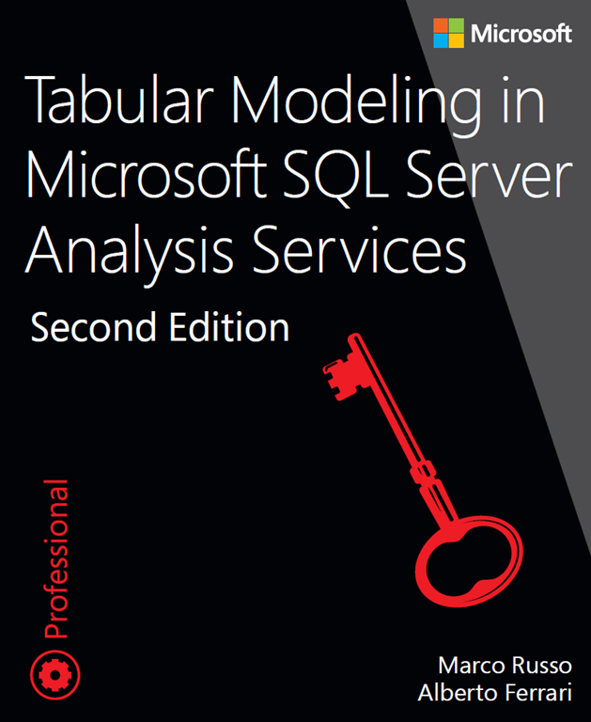
References
https://docs.microsoft.com/en-us/sql/analysis-services/tabular-models-scripting-language-objects/tmsl-reference-tabular-objects
https://docs.microsoft.com/en-us/sql/analysis-services/tabular-models-scripting-language-commands/tmsl-reference-commands
https://docs.microsoft.com/en-us/sql/analysis-services/powershell/analysis-services-powershell-reference

Slide 43
Thanks for Listening
Ust Oldfield
@uoldfield
https://github.com/uoldfield/TabularAutomation
blogs.adatis.co.uk/ustoldfield

